Slide 1

Internet of Everything Module 3. Principles of Connected Devices and Protocols in IoT
IT – BE – IoE
Prof. Nita Patil
Assistant Professor
Dept. of Electronics & Computer Science,
SIES Graduate School of Technology

Slide 2
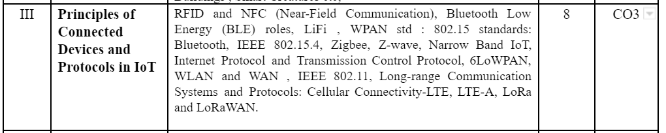
Book :
David Hanes, Gonzalo Salgueiro, Patrick Grossetete, Robert Barton, Jerome Henry, IoT Fundamentals Networking Technologies, Protocols, and Use Cases for the Internet of Things CISCO , Ch 4 ,5
Analytics for the Internet of Things (IoT) Intelligent Analytics for Your Intelligent Devices.Andrew Minteer,Packet , ch 2
Blooms level : L1,L2,L3,L4

Slide 3

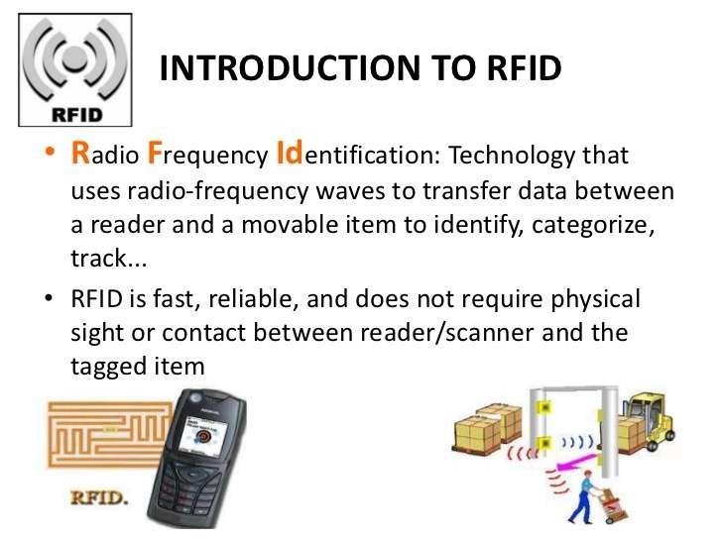

Slide 4

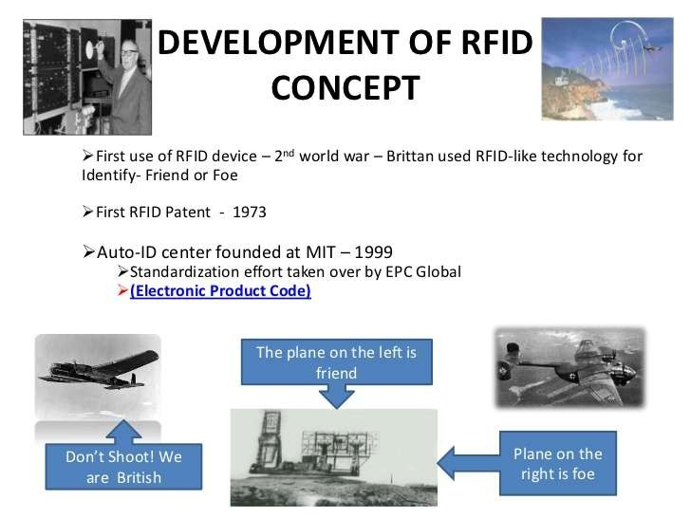

Slide 5
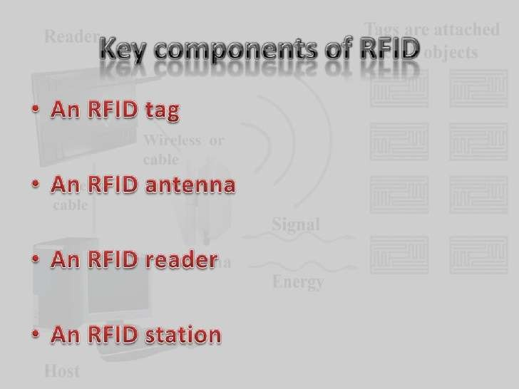

Slide 6
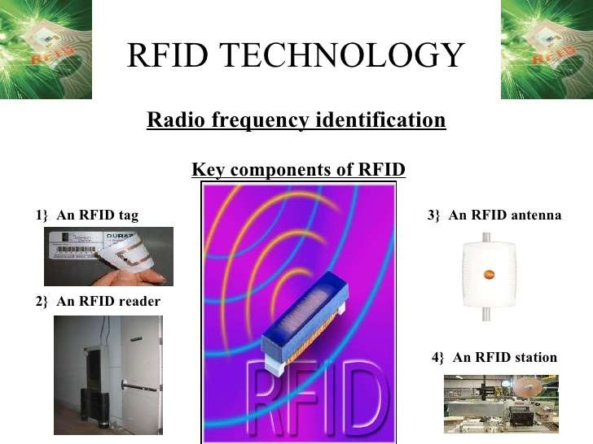

Slide 7
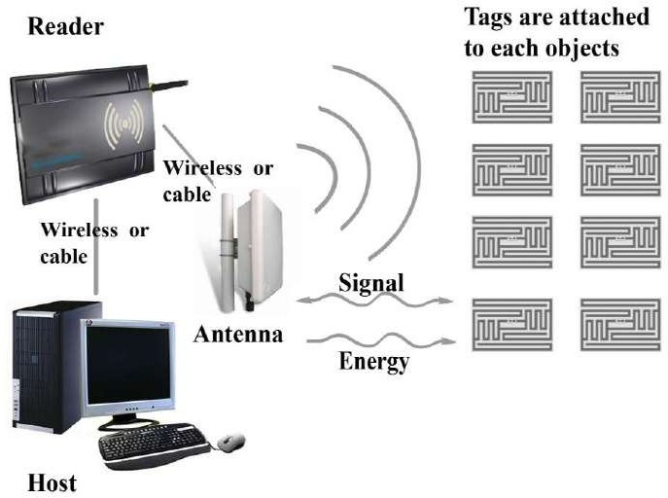

Slide 8
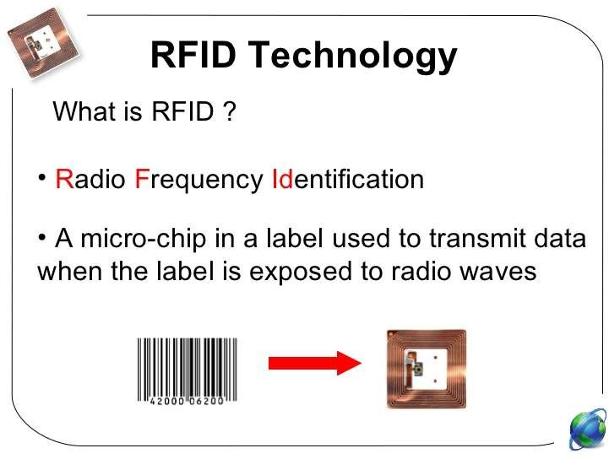

Slide 9
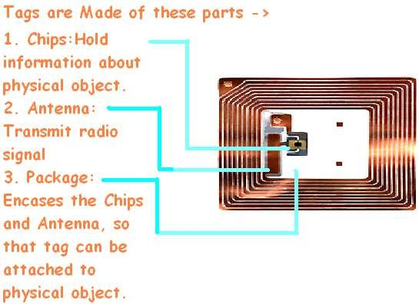
JNIT

Slide 10
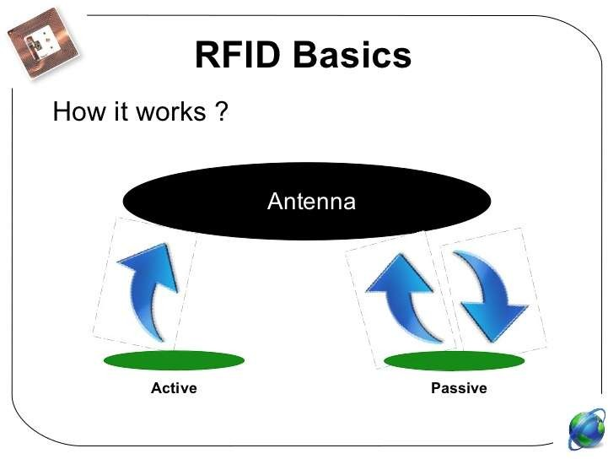

Slide 11
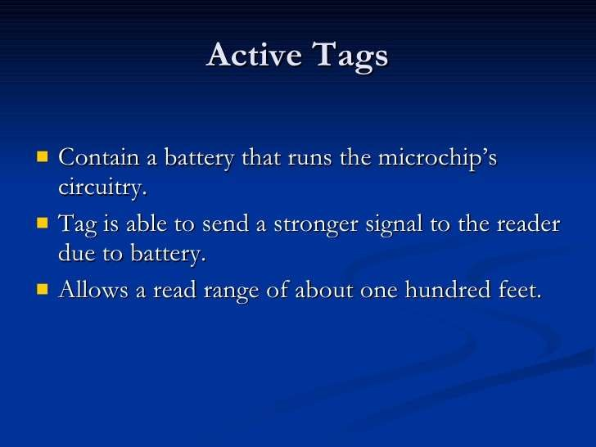

Slide 12
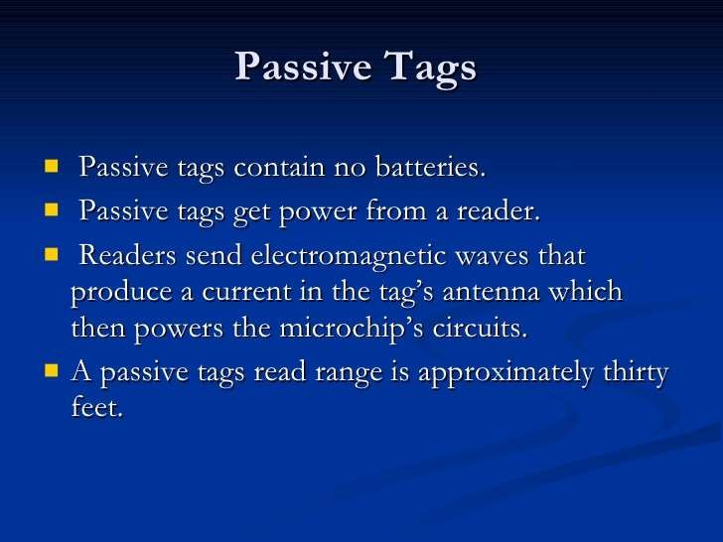

Slide 13
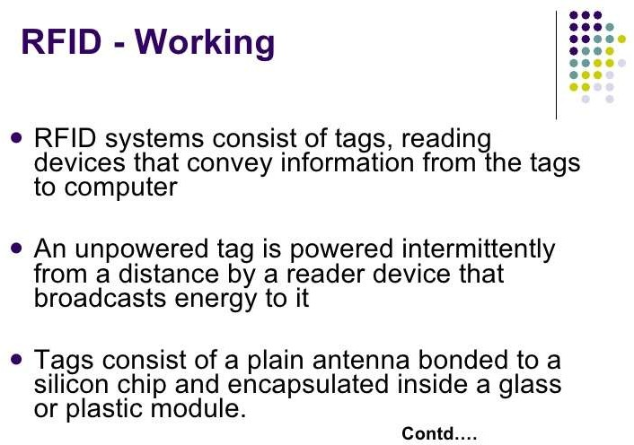

Slide 14
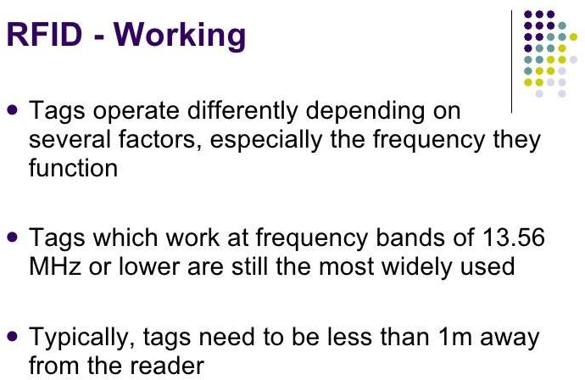

Slide 15
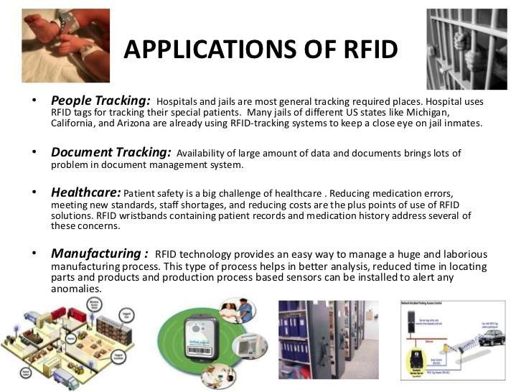

Slide 16
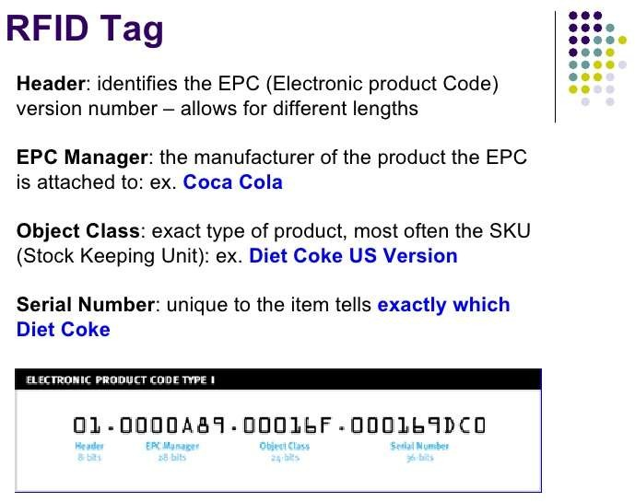

Slide 17
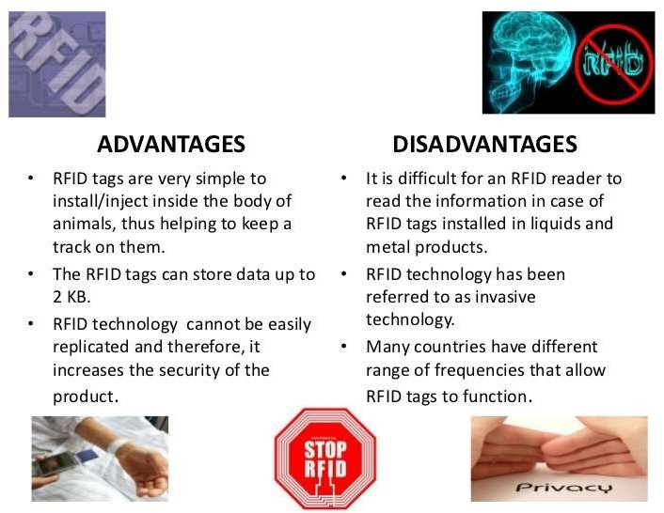

Slide 18
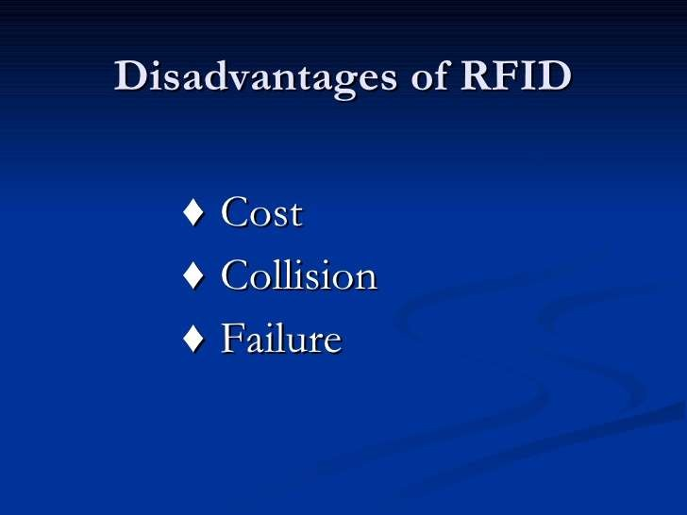

Slide 19
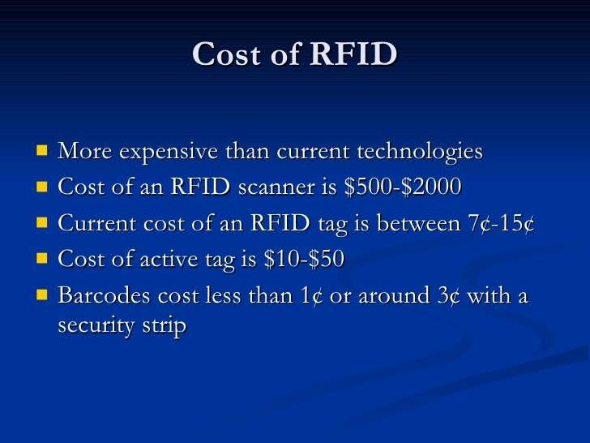

Slide 20
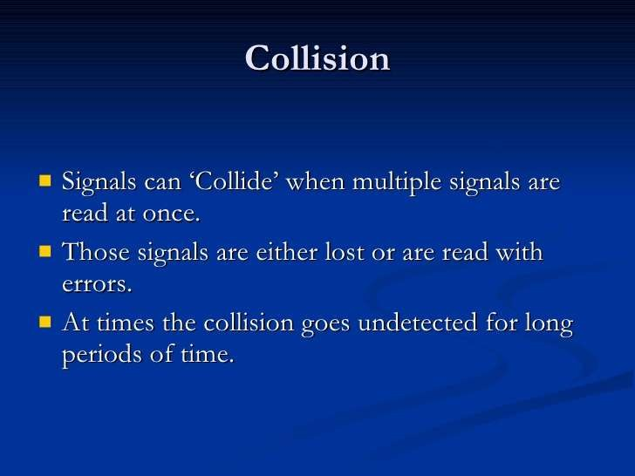

Slide 21
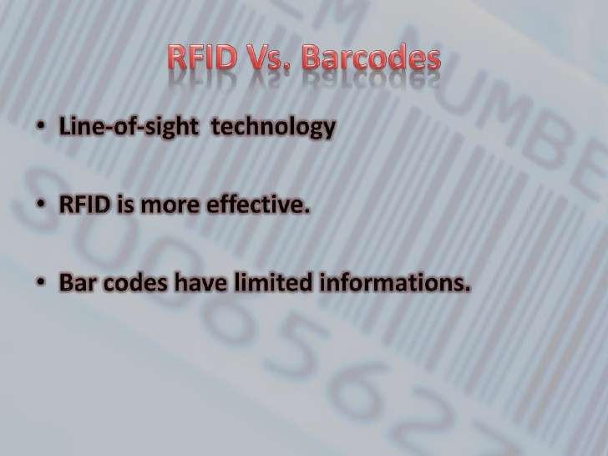

Slide 22
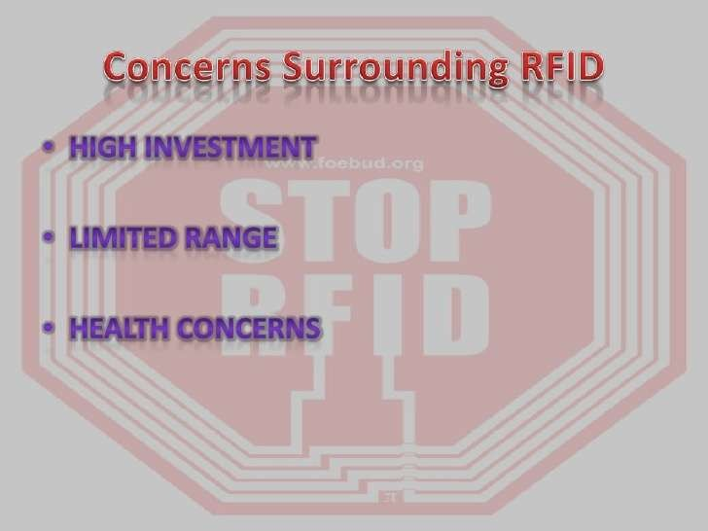

Slide 23
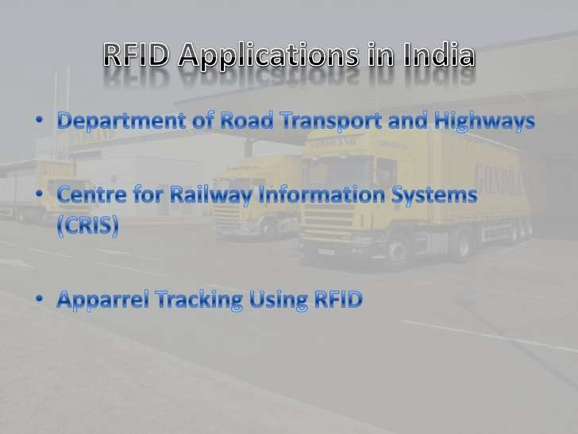

Slide 24
Introduction
The RFID system consists of a tag (also known as a transponder) attached to the object being identified
– integrated circuit and an antenna.
Reader-queries the tag using radio frequency (RF) waves, and gets the identity of the tag via the RF waves.
The RFID systems operate in various frequency bands.

Slide 25
Introduction
Some of the most popular frequencies are:
– 125 kHz to 134.2 kHz (LF: low frequency);
– 13.56 MHz (HF: high frequency);
– 860 to 915 MHz (UHF: ultra-high frequency); and
– 2.45 GHz to 5.8 GHz (microwave frequency).

Slide 26
Introduction
The RFID systems operating in the LF band were the first to be deployed in the market for high- volume short-range industrial applications and car immobilizer devices.
These systems are attractive in systems where the
data rates are not very high.

Slide 27
Introduction
The HF RFID systems are capable of handling much higher data rates compared to the LF system,
– and the tag antenna is much smaller.
HF systems have longer read range compared to the LF systems.
The UHF RFID system has a much longer read range and much higher data rate compared to the LF and HF systems.
However, the UHF system does not work very well in the presence of metallic objects, water and the human body, compared to the LF system.

Slide 28
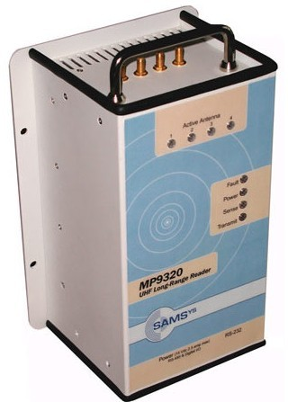
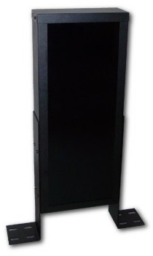
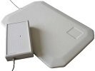
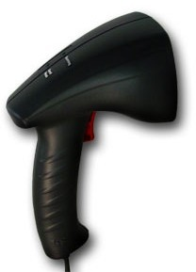
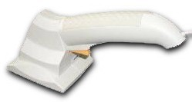
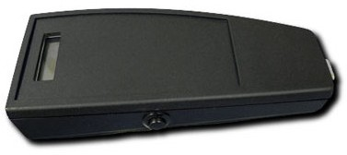
Some RFID readers
Source: www.b¹u³yrfid.org

Slide 29
RFID tag memory
•
Read-only tags
Tag ID is assigned at the factory during manufacturing
Can never be changed
No additional data can be assigned to the tag Write once, read many (WORM) tags
Data written once, e.g., during packing or manufacturing
Tag is locked once data is written
Similar to a compact disc or DVD Read/Write
Tag data can be changed over time
Part or all of the data section can be locked
•
•
15

Slide 30
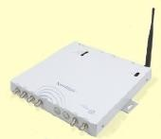
RFID readers
•
Reader functions:
Remotely power tags
Establish a bidirectional data link
Inventory tags, filter results
Communicate with networked server(s)
Can read 100-300 tags per second
Readers (interrogators) can be at a fixed point such as
Entrance/exit
Point of sale
Readers can also be mobile/hand-held
•
•
16

Slide 31
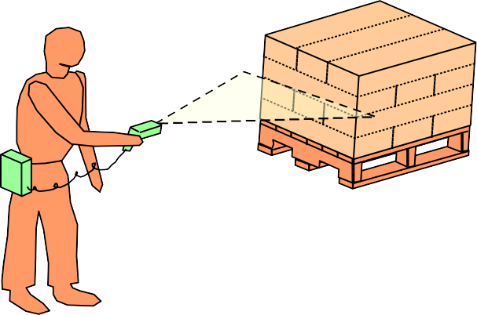
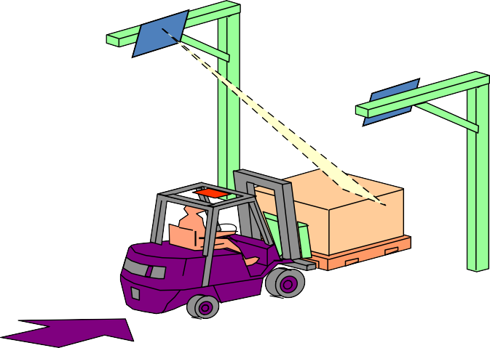
RFID application points
Assembly Line
♣ Handheld Applications
♣ Shipping Portals
17

Slide 32
RFID applications
Manufacturing and Processing
Inventory and production process monitoring
Warehouse order fulfillment
Supply Chain Management
Inventory tracking systems
Logistics management
Retail
Inventory control and customer insight
Auto checkout with reverse logistics
Security
Access control
Counterfeiting and Theft control/prevention
Location Tracking
Traffic movement control and parking management
Wildlife/Livestock monitoring and tracking
•
•
•
•
18

Slide 33
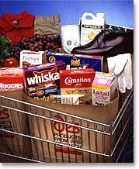
Smart groceries
•
Add an RFID tag to all items in the grocery.
•
As the cart leaves the store, it passes through an RFID transceiver.
•
The cart is rung up in seconds.
19

Slide 34
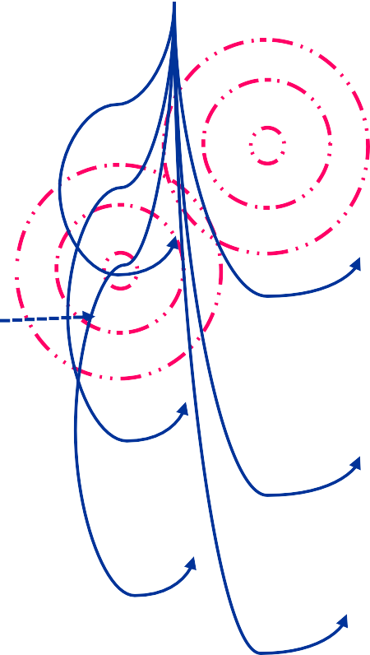

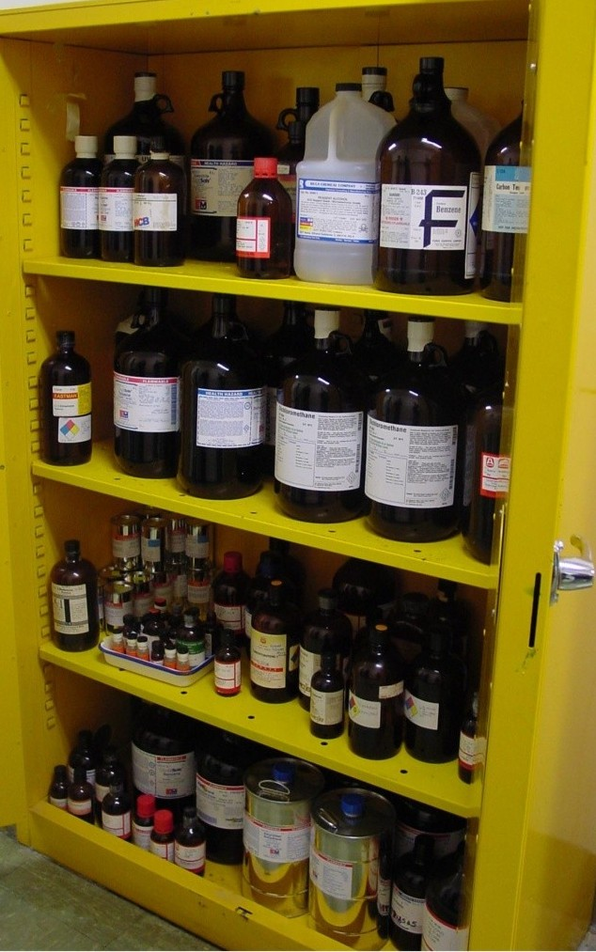






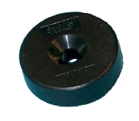
Smart cabinet
Reader antennas placed under each shelf
1. Tagged item is removed from or placed in “Smart Cabinet”
“Smart Cabinet” periodically interrogates to assess inventory
Server/Database is updated to reflect item’s disposition
4. Designated individuals are notified regarding items that need attention (cabinet and shelf location, action required)
Passive read/write tags affixed to caps of containers

Slide 35
Smart fridge
Recognizes what’s been put in it
Recognizes when things are removed
Creates automatic shopping lists
Notifies you when things are past their expiration
Shows you the recipes that most closely match what is available
21

Slide 36
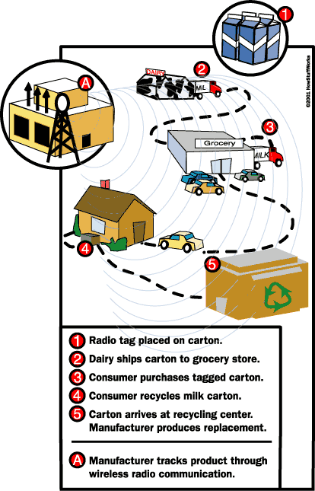
Smart groceries enhanced
•
Track products through their entire lifetime.
Source: How S²²tuff Works

Slide 37
Some more smart applications
•
“Smart” appliances:
Closets that advice on style depending on clothes available.
Ovens that know recipes to cook pre-packaged food.
“Smart” products:
Clothing, appliances, CDs, etc. tagged for store returns.
“Smart” paper:
Airline tickets that indicate your location in the airport.
“Smart” currency:
Anti-counterfeiting and tracking.
•
•
•
•
“Smart” people ??
23

Slide 38
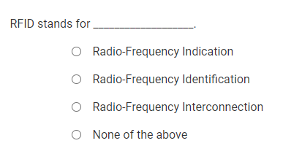

Slide 39
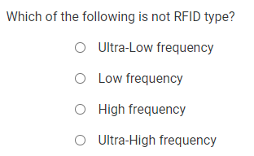

Slide 40
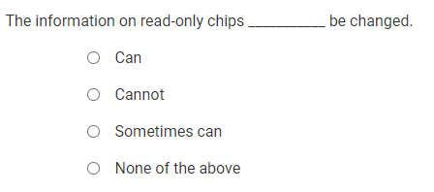

Slide 41
Principle of RFID
https://www.youtube.com/watch?v=Ukfpq71BoMo
Consider a coil made of copper wire through which
alternating current is flowing.
The coil offers impedance to the source and a voltage develops across its terminals.
It is possible to increase the voltage by connecting a capacitor in parallel with the coil.
“primary” coil

Slide 42
Principle of RFID
Another coil-“secondary” coil,
Close to the first.
Due to electromagnetic induction, voltage appears across the terminals of the secondary coil.
The amplitude of the voltage depends on the size, shape, location and orientation of the secondary coil.
If we connect a resistor (also known as a load) across the terminals of the secondary coil, current flows through it.

Slide 43
Principle of RFID
The primary coil can be thought of as the reader of the RFID system, and the secondary coil as the transponder or tag.
The tag can convey any message back to the reader using RF signals, by simply changing the load connected to its terminals.
This could be achieved by switching in a load to represent a logical state 1 and taking off the load to represent a logical state 0.

Slide 44
Antenna fields: Inductive coupling
IC or microprocessor
RFID
Tag
Transceiver
Tag Reader
antenna
antenna

Slide 45
Antenna fields: Propagation coupling
IC or microprocessor
RFID
Tag
Transceiver
Tag Reader
antenna
antenna

Slide 46
RFID Middleware
A typical RFID system can have
several readers and tags (operating in different frequency bands and using various protocols),and
several applications accessing these tags via the readers.
It is important to provide a seamless connectivity between the RFID hardware and the application by insulating the applications from the RFID hardware.

Slide 47
RFID middleware
General middleware architecture three components
– device interface;
– core processing interface;
– application interface
is comprised of

Slide 48
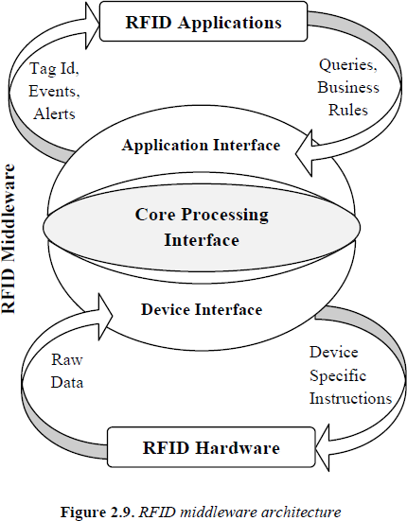

Slide 49
Issues
An RFID system has a high reliability when operating under controlled conditions.
a reader trying to read a tag
As long as the tag is within a specific distance of the reader antenna
In a practical scenario,
the tag is attached to an object whose electrical properties are different to that of free space.
This generally degrades the performance of the tag (in exceptional circumstances it can enhance the performance).

Slide 50
Issues
Several tags try to communicate with the reader and several readers trying to read several tags at the same time.
This results in a collision of data being transferred between the readers and tags.
Algorithms to avoid collisions have been proposed and successfully used to solve some of these issues.

Slide 51
Issues
Several tags in the vicinity of the reader,
Tags has a unique serial number.
If the reader issues a command asking the tags to respond back with their serial numbers
All the tags receiving this command will respond back with their respective serial numbers, causing collision.

Slide 52
Issues
The reader can perform read and write operations
on the selected tag.
If there is a collision, the reader issues another request command by lowering the value of the parameter, thereby targeting a smaller group of tags to respond.

Slide 53
Issues
Propagation of electromagnetic waves is influenced by the environment.
Therefore, the amount of energy reaching the tag antenna depends on the interaction of the waves and the environment in which the reader and the tag are placed.

Slide 54
Issues
The transmission power of the reader is increased in steps of 0.1 dB and an attempt is made to read the tag.
The lowest transmission power at which a tag is read, which is known as the “threshold power”, is recorded.
Threshold power is the smallest transmission power required to detect (read) the tag with all other parameters held constant.
It is also possible to measure the threshold power for
writing data into a tag.
– less challenging.

Slide 55
Issues
Privacy of data stored in the tag becomes an issue when these are associated with people.
For example, in the retail sector,
– it is possible to link the product (via the data stored in the tag attached to it) and the person buying it (through his or her credit card number).
If a tag can be associated with a person (via a tag stuck on the shirt that the person is wearing), the RFID system using a collection of stationary readers could be used to track the person’s movement.

Slide 56
Issues
Security of information stored on the tag also plays a crucial role in several applications.
Issues such as tampering with the data stored in the tag,
altering the association between the tag and the product,
Collecting security-related data stored on the tags, etc. have prompted designers to implement encryption techniques to secure the information on the tag itself.

Slide 57
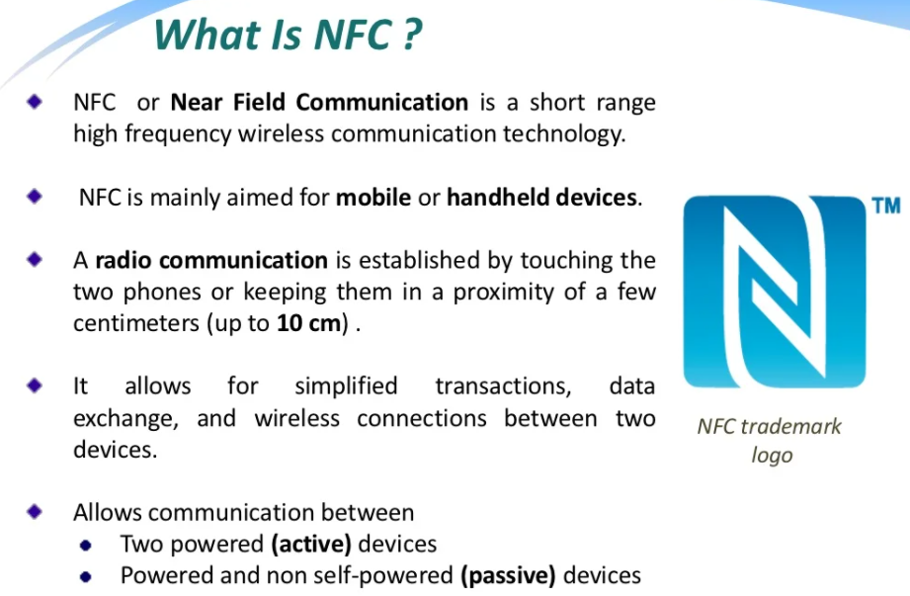
NFC (Near Field Communication)

Slide 58
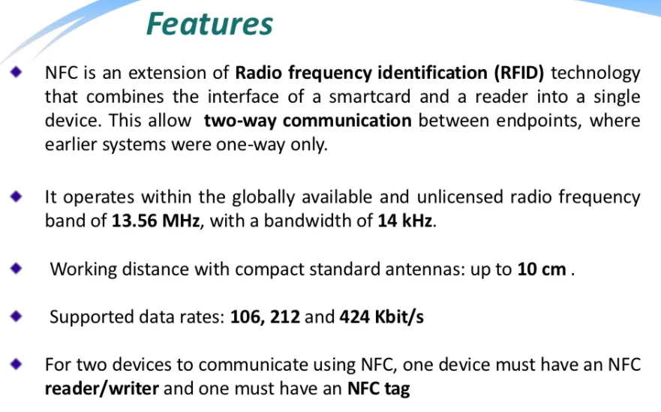

Slide 59
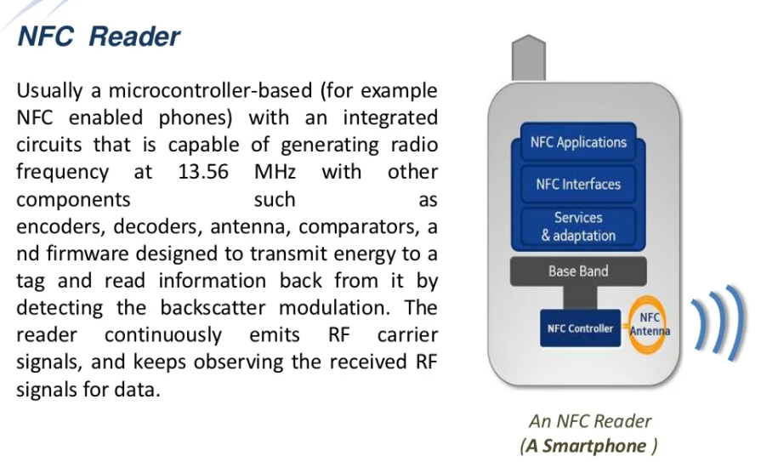

Slide 60
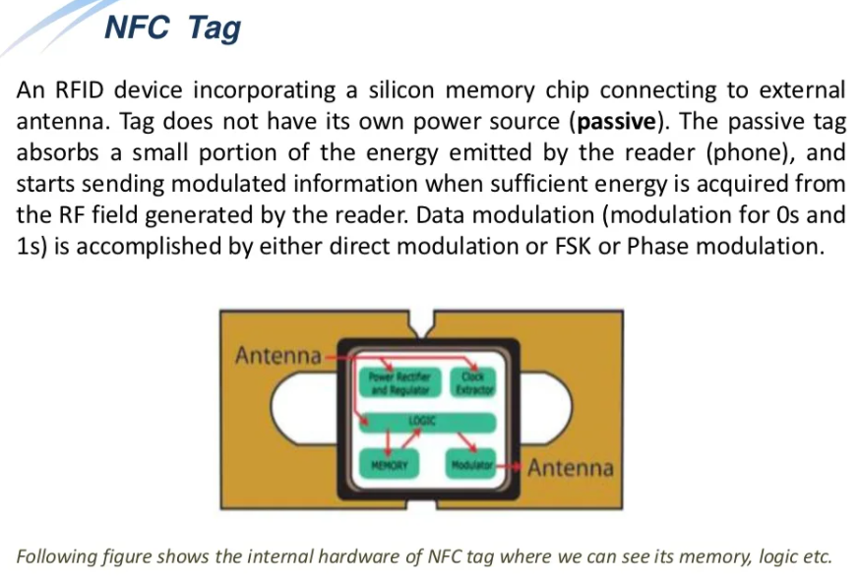

Slide 61
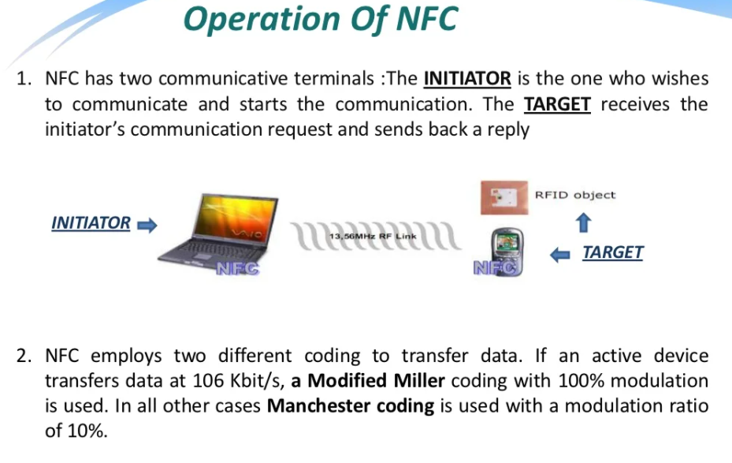

Slide 62
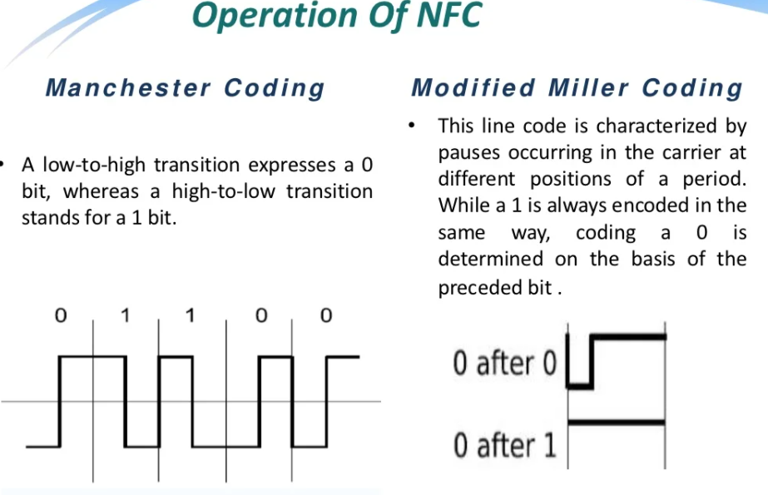

Slide 63
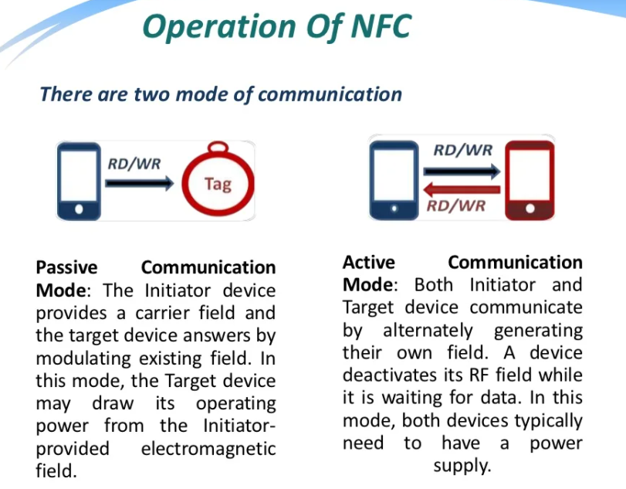

Slide 64
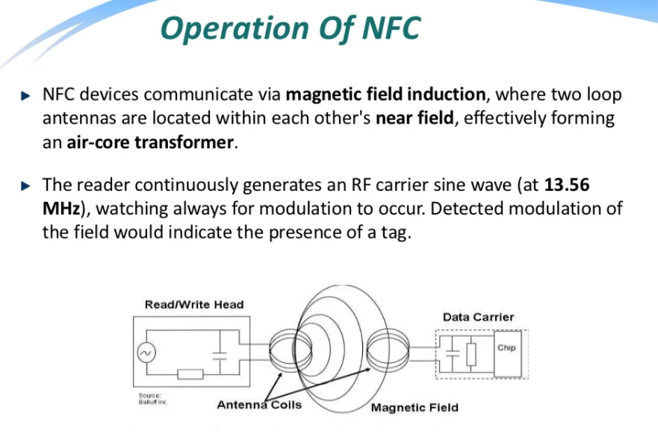

Slide 65
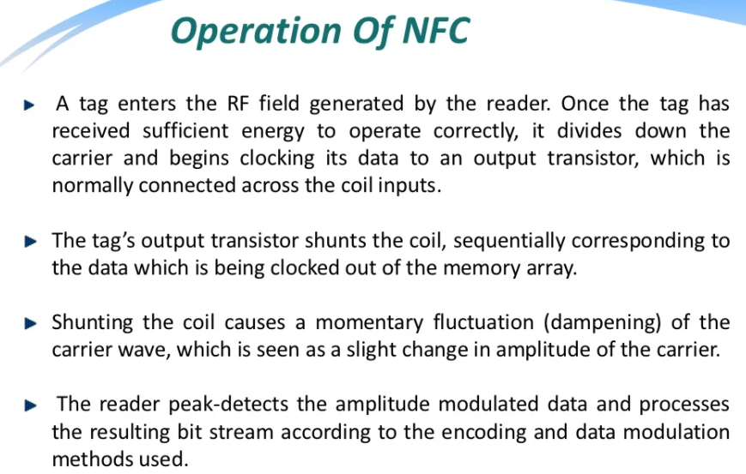

Slide 66
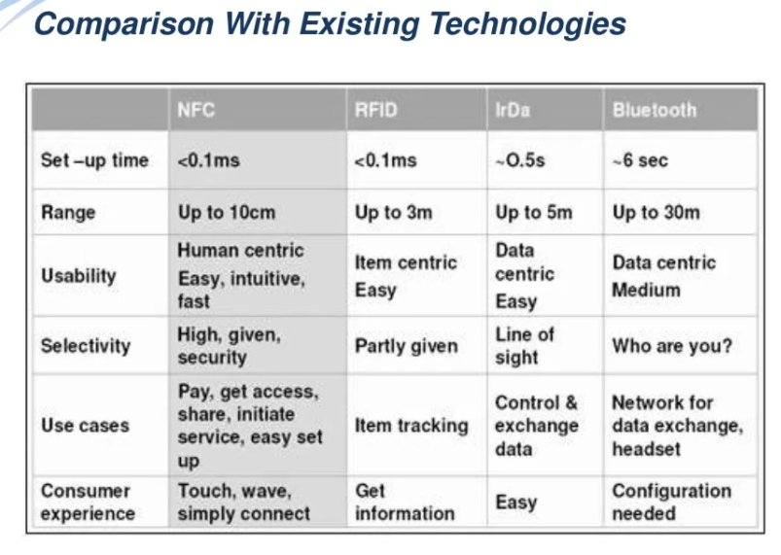

Slide 67


Slide 68


Slide 69


Slide 70


Slide 71


Slide 72


Slide 74


Slide 75


Slide 76
Indoor Positioning System
Real Time Locating Systems (RTLS)

Slide 77
Real Time Locating Systems (RTLS) provide knowledge by delivering precise visibility of critical assets, supply chain, manufacturing, and human, in real-time.
For transportation and logistics enterprises, this knowledge means having end-to-end visibility and Traceability of all Containers, pallets, and packages.
For manufacturers, it enables intelligent management and flow of all critical assets, whether in the facility or at a sprawling storage yard.

Slide 78
Under security and safety operations, it means controlling employee access and ensuring they do not linger in hazardous areas beyond safety requirements.
RTLS or indoor positioning systems (IPS) can be simply described as GPS on steroids but used indoors for the purpose of Tracking, locating and monitoring the activity of people and things.

Slide 79
It is used in healthcare, manufacturing, smart warehouses, hospitality, education, and other industries for the purpose of maximizing workflow efficiency, safety, wayfinding, and inventory and asset control and has been proven to deliver significant return on investment (ROI).

Slide 80


Slide 81


Slide 82


Slide 83


Slide 84


Slide 85


Slide 86


Slide 87


Slide 88


Slide 89



Slide 90


Slide 91


Slide 92


